Slide 1
Refactor code with best practice
Modify the structure of API to ensure the best maintenance of code and reduce the regressions.
Write a best code following the best practice at this link https://confluence.gft.com/display/ISPP/Code+Review+Rules

Slide 2
How to structure the development of an API
One API for controller
Command without business logic and call service using the interface
Service with business logic. One implementation for tipoPratica with a common service to centralize the common logic
Connector to call external services

Slide 3
Controller (1 API)
Command
Service Interface
If tipoPratica = NCCCC or NCCRS
If tipoPratica = INCRE
If tipoPratica = BPPRP
Service tipoPratica NCC
Service tipoPratica Poste
Service tipoPratica IC
Common Service
If exist common logic
Connector
Connector
Connector
Connector

Slide 4
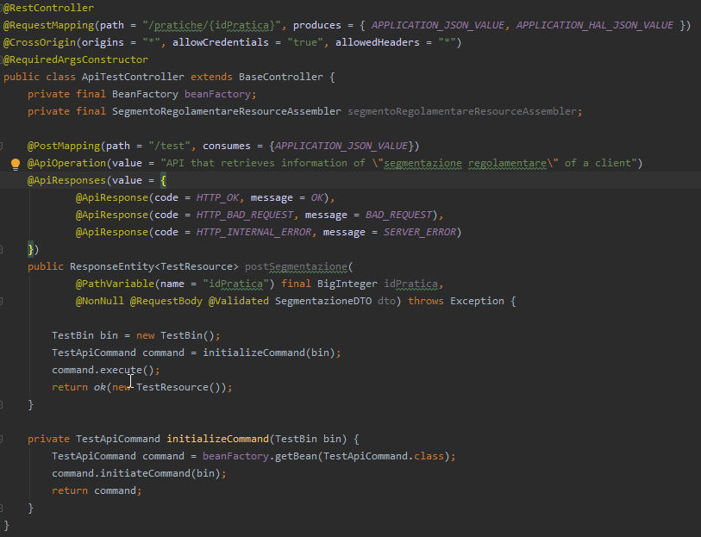
Example of implementation
Controller

Slide 5
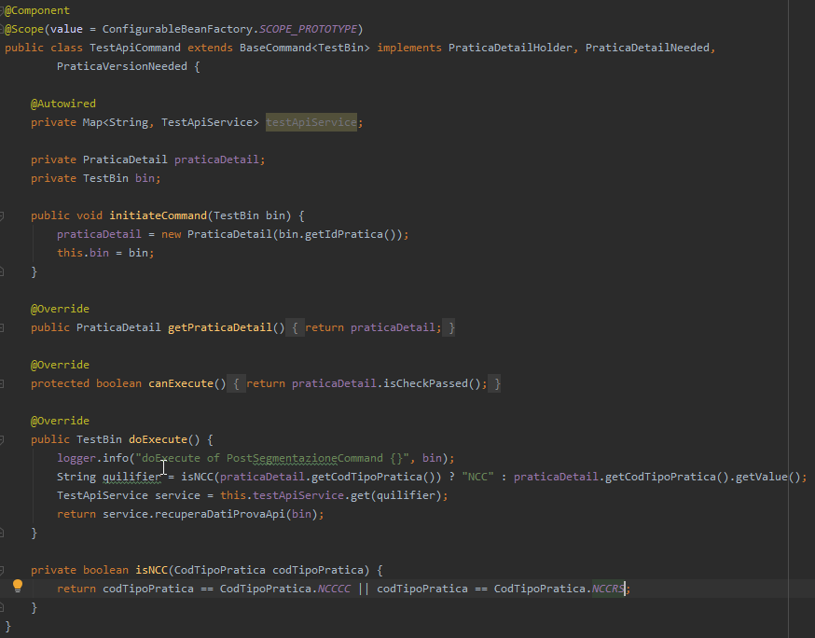
Example of implementation
Command

Slide 6
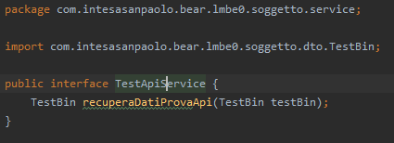
Example of implementation
Service Interface

Slide 7
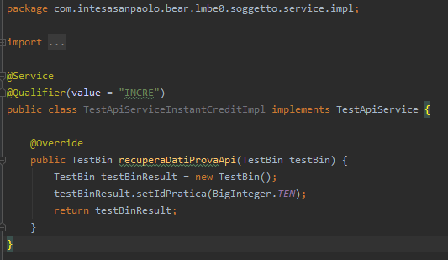
Example of implementation
Service Implementation Instant Credit

Slide 8
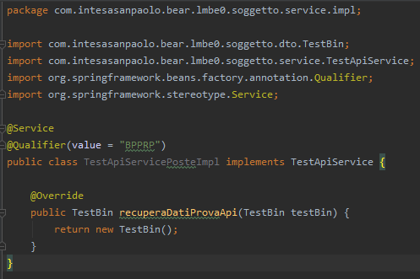
Example of implementation
Service Implementation Poste

Slide 9
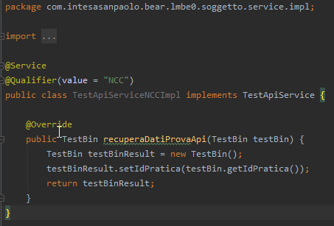
Example of implementation
Service Implementation NCC

Slide 10
Best practice to development
Use utility or Optional to be null safe
Example:
list.get(0) → Iterables.getFirst(list, <default if list is empty or null>)
string1.equals(string2) →StringUtils.equals(string1, string2)
object.getFlg1() → BooleanUtils.toBoolean(object.getFlg1())
list.stream()… →CollectionUtils.emptyIfNull(list).stream()…
object.getA().getB() → Optional.ofNullable(object.getA()).map(…).orElse(…)
One method must have one only responsability.
Maximun 3 parameters for method. If are neccessary more parameters use object
Name of variables, methods, class… must to be clears. The words get and set are reserved only for getters and setters and not for other methods
When is necessary more times the same “object.get…” to extract a variable
If is necessary, the same logic in more points put it in a common method or in a common class
To create test classes use the shortcut CTRL+SHIFT+T so they will be placed in correct package
When there are the constants values make them as private static final
Write log
Use annotation @Autowired to inject the bean Spring

Slide 11

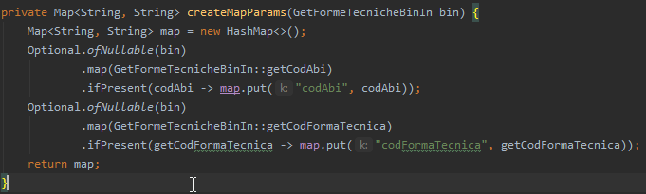
Best practice to development in BEAR
Read this how to https://confluence.gft.com/display/ISPP/How+to+develop+with+BEAR
Make sure that when we are creating request, we are using correct params (path params or query params) and set correct value for request. Optional parameters should be handled optionally
PraticaDetailHolder is the interface needed for the praticaDetail object. Basically used in every Commands.
PraticaDetailNeeded, at the moment, is only needed to retrieve pratica information, such as CodTipoPratica. Use this when you need to separate logic between Poste and NCC for example.
PraticaVersionNeeded is used to retrieve numVersion and numVersionByPhase. You don’t need to check if codFasePratica exists and take either numVersion or numVersionByPhase
If codFasePratica is not passed on input, numVersionByPhase is null.
If codFasePratica is passed and exists on DB, numVersionByPhase is filled.
If codFasePratica is passed and doesn’t exist on DB, an exception is thrown by AOP.
All you have to do is set numVersionByPhase in your Bin and then check if it is null then call versioningDelegate.findCurrentAll otherwise versioningDelegate.findHistoricalAll.

Slide 12
All you have to do is set numVersionByPhase in your Bin and then check if it is null then call versioningDelegate.findCurrentAll otherwise versioningDelegate.findHistoricalAll.
One connector for External Service

